Slide 1
Expert Labs Tech Fest October 2022
AMAUT34_Tech Fest - MQ Statistics, What is available. How do you access them
Bobbee Broderick
rkbroder@us.ibm.com
Notes:
Good morning, everyone!
We’re going to be recording this call, so if you have any objections to that, please disconnect at this time.
HIT RECORD!!!!!
Thank you all for joining this Expert Labs Tech Fest Session, AMAUT34_Tech Fest - MQ Statistics . I’m your event host, Bobbee Broderick, AVP/EC TAM here in Expert Labs. We’re going to kick-off this presentation in just a moment.

Slide 2
AMAUT34_Tech Fest - MQ Statistics AUT34_Tech Fest - MQ Statistics
Important Disclaimer
THE INFORMATION CONTAINED IN THIS PRESENTATION IS PROVIDED FOR INFORMATIONAL PURPOSES ONLY.
WHILE EFFORTS WERE MADE TO VERIFY THE COMPLETENESS AND ACCURACY OF THE INFORMATION CONTAINED IN THIS PRESENTATION, IT IS PROVIDED “AS IS”, WITHOUT WARRANTY OF ANY KIND, EXPRESS OR IMPLIED.
IN ADDITION, THIS INFORMATION IS BASED ON IBM’S CURRENT PRODUCT PLANS AND STRATEGY, WHICH ARE SUBJECT TO CHANGE BY IBM WITHOUT NOTICE.
IBM SHALL NOT BE RESPONSIBLE FOR ANY DAMAGES ARISING OUT OF THE USE OF, OR OTHERWISE RELATED TO, THIS PRESENTATION OR ANY OTHER DOCUMENTATION.
NOTHING CONTAINED IN THIS PRESENTATION IS INTENDED TO, OR SHALL HAVE THE EFFECT OF:
CREATING ANY WARRANTY OR REPRESENTATION FROM IBM (OR ITS AFFILIATES OR ITS OR THEIR SUPPLIERS AND/OR LICENSORS); OR
ALTERING THE TERMS AND CONDITIONS OF THE APPLICABLE LICENSE AGREEMENT GOVERNING THE USE OF IBM SOFTWARE.
Information regarding potential future products is intended to outline our general product direction and it should not be relied on in making a purchasing decision. The information mentioned regarding potential future products is not a commitment, promise, or legal obligation to deliver any material, code or functionality. Information about potential future products may not be incorporated into any contract. The development, release, and timing of any future features or functionality described for our products remains at our sole discretion.
Notes:
This is the normal disclaimer for presentation. Nothing interesting here, Just move on!!

Slide 3
AMAUT34_Tech Fest - MQ Statistics AUT34_Tech Fest - MQ Statistics
Agenda:
Online Status commands
MQExplorer
AMQSRUA
Event Messages
Queue
Manager
MQConsole
(Monitor MQAppliance)
Offline
Account and Statistics
Notes:
MQ, for a lot of customers is a BLACK BOX
Many people are benefactors of its feature. Few of those people understand it or what is going on.
People don’t care about MQ until it breaks and effects them
MQ does not have to be the quiet Wall flower
MQ provides very useful information on it’s processing and state
Online Status commands offer real time information on object status, application status and communication status
Event Messages are important for things that have happened n the system. But will not be covered here
Offline Account and Status give metrics for how the Queue Manager and it’s objects have been used
The MQ Appliance offers pretty much the same information MQExplorer offers. It will not be covered.
New to MQ is the System Stats interface. The sample program, amqsrua, give insight into how to get accessd to this information in a real time fashion.
Amqsrua is DEMOED at the end of this presentation. It is the topic of interest for this session and I am giving the participants access to working scripts for accessing this infor ans storing it in a file. This can be easily modified to store it in a DB for processing.

Slide 4
AMAUT34_Tech Fest - MQ Statistics AUT34_Tech Fest - MQ Statistics
On-line status commands
Available via
MQSC commands
Programmable Command Format (PCF)
MQ Explorer GUI
Queue Manager
Resources
Queues
Channels
Topics
Applications
Connections
Handles
Subscriptions
Notes:
MQ produces a good amount of information. There are several ways to get to the data
MQSC
Internal command format for requests and replies into the queue manager via a command line tool interacting with the MQ Command server
Access through the command line on the server hosting the Queue Manager by entering ‘runmqsc’
Requires a certain level of access for the UID executing the commands
Allows access to Queue Manager, Queues, Channels, etc
You can Inquire, Create, Delete and Alter MQ objects
PCF
Proprietary MQ command format for IBM MQ
Programmable Command Formats (PCFs) define command and reply messages that can be exchanged between a program and any queue manager (that supports PCFs) in a network
PCFs simplify queue manager administration and other network administration
Lends itself more to an application approach of processing MQ Events and Statistics that MQSC commands.
MQ Explorer
Graphical interface to MQ
Was part of media, as of v9.3 becomes a download only
MQExplorer - https://www.ibm.com/support/pages/ms0t-ibm-mq-explorer
Allows Inquire, create, change and delete of MQ objects
Provides the ability to create clusters and other MQ Architectural approaches
Access to statistics and events (MS02 Support pack)

Slide 5
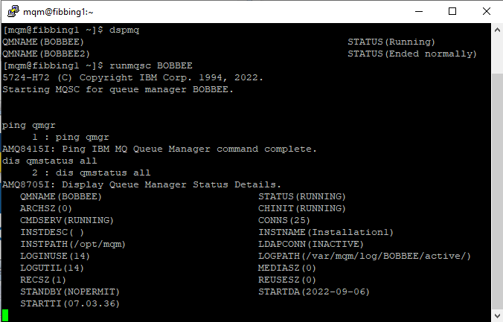
AMAUT34_Tech Fest - MQ Statistics AUT34_Tech Fest - MQ Statistics
Queue Manager Status Commands
“Is the queue manager alive” ?
Control Command
dspmq
MQSC Commands
ping qmgr
Test if QMGR is responsive to commands
Display qmstatus all
Run-time state of the QMGR
Notes:
‘dspmq’. Command line, displays the Queue Manager (active and Ended) on the local server
ping <qmgr> sends a signal to an active queue manager expecting a response.
Runmqsc command ‘dis qmstatus all’, display status information associated with this queue manager.
CHINIT The status of the channel initiator
CMDSERV The status of the command server.
CONNS The current number of connections to the queue manager.
CURRLOG The name of the log extent being written to
INSTDESC Description of the installation associated with the queue manager.
INSTNAME Name of the installation associated with the queue manager.
LDAPCONN The status of the connection to the LDAP server.
MEDIALOG The name of the oldest log extent required by the queue manager to perform media recovery.
QMNAME The name of the queue manager.
RECLOG The name of the oldest log extent required by the queue manager to perform restart recovery.
STANDBY Whether a standby instance is permitted.
STATUS The status of the queue manager.
STARTDA The date on which the queue manager was started
STARTTI The time at which the queue manager was started

Slide 6
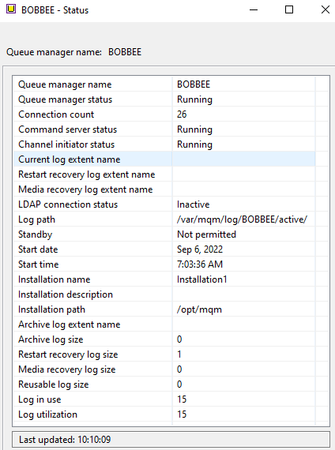
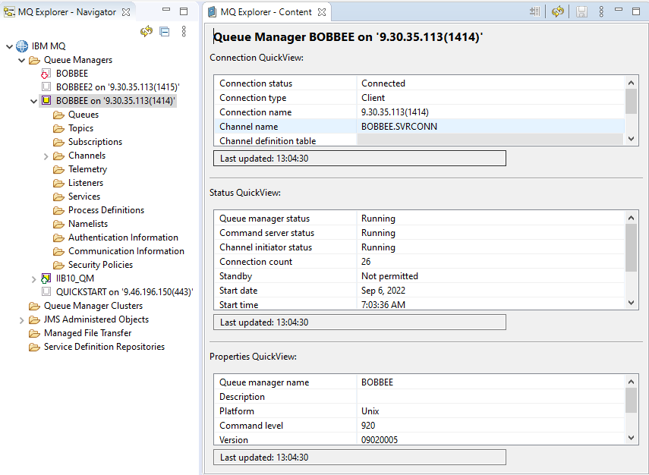
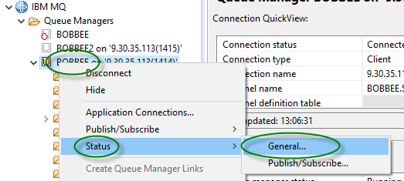
AMAUT34_Tech Fest - MQ Statistics AUT34_Tech Fest - MQ Statistics
Queue Manager Status MQExplorer
Notes:
Queue Manager status through MQExplorer MQ GUI
AS shown, it’s a series of ‘right clicks’ on the QMGR ➔ STSTUS ➔ General
Shows in a graphical presentation the same information as the command line tool

Slide 7
AMAUT34_Tech Fest - MQ Statistics AUT34_Tech Fest - MQ Statistics
Queue Status
DISPLAY QSTATUS TYPE(QUEUE) command
Last message Put/Get date and time
Age of oldest message on queue in seconds
DIS QSTATUS(BOBBEE_IN) TYPE(QUEUE)
3 : DIS QSTATUS(BOBBEE_IN) TYPE(QUEUE)
AMQ8450I: Display queue status details.
QUEUE(BOBBEE_IN) TYPE(QUEUE)
CURDEPTH(12) CURFSIZE(1)
CURMAXFS(2088960) IPPROCS(0)
LGETDATE( ) LGETTIME( )
LPUTDATE(2022-10-04) LPUTTIME(11.15.56)
MEDIALOG( ) MONQ(MEDIUM)
MSGAGE(135) OPPROCS(0)
QTIME( , ) UNCOM(NO)
Notes:
Status information is held for each queue
QSTATUS can be accessed through the command line runmqsc command
DIS QSTSTUS
TYPE – QUEUE
OPENTYPE – ALL, INPUT, OUTPUT
STATUS
CURDEPTH, IPPROCS, LGETDATE, LGETTIME, LPUTDATE, LPUTTIME, MEDIALOG, MONQ, MSGAGE, OPPROCS, QSGDISP, QTIME, UNCOM

Slide 8
AMAUT34_Tech Fest - MQ Statistics AUT34_Tech Fest - MQ Statistics
DISPLAY QSTATUS TYPE(HANDLE) command
Handles currently open against a queue
DIS QSTATUS(BOBBEE_IN) TYPE(HANDLE)
16 : DIS QSTATUS(BOBBEE_IN) TYPE(HANDLE)
AMQ8450I: Display queue status details.
QUEUE(BOBBEE_IN) TYPE(HANDLE)
APPLDESC( ) APPLTAG(amqsput)
APPLTYPE(USER) BROWSE(NO)
CHANNEL( ) CONNAME( )
ASTATE(NONE) HSTATE(INACTIVE)
INPUT(NO) INQUIRE(NO)
OUTPUT(YES) PID(12885)
QMURID(0.0) SET(NO)
TID(1)
URID(XA_FORMATID[] XA_GTRID[] XA_BQUAL[])
URTYPE(QMGR) USERID(mqm)
Notes:
Status information is held for each queue
QSTATUS can be accessed through the command line runmqsc command
DIS QSTSTUS
TYPE – HANDLE
OPENTYPE – ALL, INPUT, OUTPUT
HANDLE
APPLDESC, APPLTAG, APPLTYPE, ASID, ASTATE, BROWSE, CHANNEL, CONNAME, HSTATE, INPUT, INQUIRE, OUTPUTP, ID, PSBNAME, PSTID, QMURID, QSGDISP, SET, TASKNO, TID, TRANSID, URID, URTYPE, USERID

Slide 9
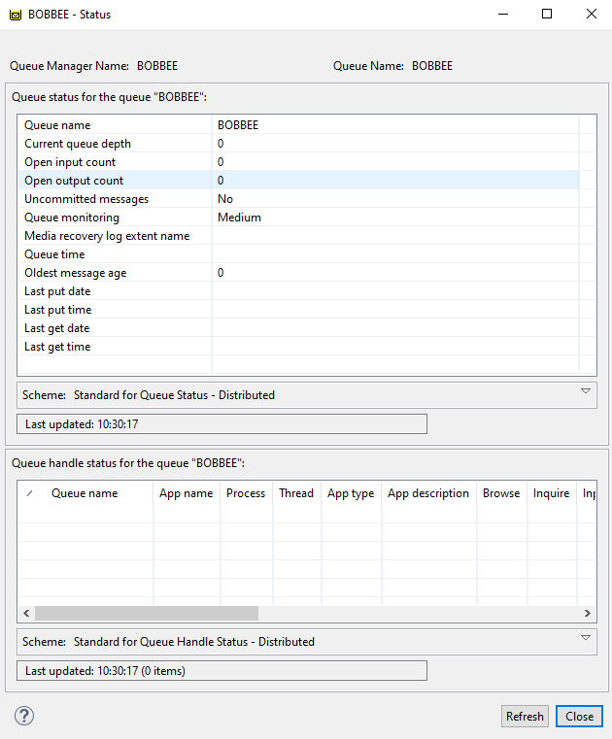
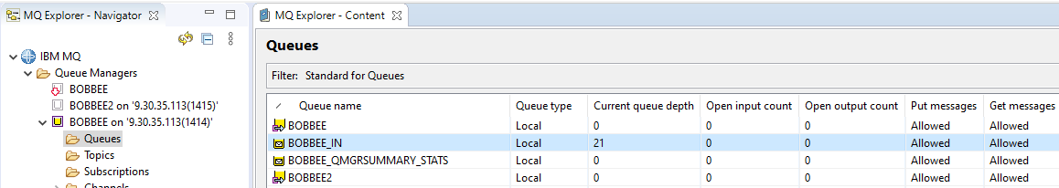
AMAUT34_Tech Fest - MQ Statistics AUT34_Tech Fest - MQ Statistics
DISPLAY QSTATUS MQExplorer
Run-time information about queues
Notes:
Queue Status through MQExplorer MQ GUI
AS shown, click on Queues under QMGR and right click on a Queue ➔ Status
Shows in a graphical presentation the same information as the command line tool
The MQExplorer will display both Queue and Handle Status on a single screen

Slide 10
AMAUT34_Tech Fest - MQ Statistics AUT34_Tech Fest - MQ Statistics
CHANNEL STATUS
DIS CHS(BOBBEE.TO.BOBBEE2) ALL
1 : DIS CHS(BOBBEE.TO.BOBBEE2) ALL
AMQ8417I: Display Channel Status details.
CHANNEL(BOBBEE.TO.BOBBEE2) CHLTYPE(SDR)
BATCHES(5) BATCHSZ(50)
BUFSRCVD(6) BUFSSENT(11)
BYTSRCVD(408) BYTSSENT(2813)
CHSTADA(2022-10-04) CHSTATI(11.36.06)
COMPHDR(NONE,NONE) COMPMSG(NONE,NONE)
COMPRATE(0,0) COMPTIME(0,0)
CONNAME(9.30.35.113(1415)) CURLUWID(3853176306C92D10)
CURMSGS(0) CURRENT
CURSEQNO(5) EXITTIME(0,0)
HBINT(300) INDOUBT(NO)
JOBNAME(0000333300000001) LOCLADDR(9.30.35.113(54930))
LONGRTS(999999999) LSTLUWID(0000000000000000)
LSTMSGDA(2022-10-04) LSTMSGTI(11.39.32)
LSTSEQNO(0) MCASTAT(RUNNING)
MONCHL(MEDIUM) MSGS(5)
NETTIME(0,0) NPMSPEED(FAST)
RQMNAME(BOBBEE2) SHORTRTS(10)
SECPROT(NONE) SSLCERTI( )
SSLCIPH( ) SSLKEYDA( )
SSLKEYTI( ) SSLPEER( )
SSLRKEYS(0) STATUS(RUNNING)
STOPREQ(NO) SUBSTATE(MQGET)
XBATCHSZ(1,1) XMITQ(BOBBEE2)
XQTIME(0,0) RVERSION(09020005)
RPRODUCT(MQMM)
DISPLAY CHSTATUS command
Channel Type
Work done
Notes:
Status information is held for Channels
CHSTATUS can be accessed through the command line runmqsc command
DIS CHSTATUS
SELECTION – Current, Saved, Short
SET - XMITQ, CONNAME, CURRENT, MONITOR
Response Fields
Channel Name, CHLTYPE, CURLUWID, CURMSGS, CURSEQ, NOINDOUBT, LSTLUWID, LSTSEQNO, STATUS, ATCHESBATCHSZ, BUFSRCVD, BUFSSENT, BYTSRCVD, BYTSSENT, CHSTADA, CHSTATI, COMPHDR, COMPMSG, COMPRATE, COMPTIME, CURSHCNV, EXITTIME, HBINT, JOBNAME, KAINT, LOCLADDR, LONGRTS, LSTMSGDA, LSTMSGTI, MAXSHCNV, MAXMSGL, MCASTAT, MCAUSER, MONCHL, MSGS, NETTIME, NPMSPEED, MNAME, RAPPLTAG, RPRODUCT, RQMNAME, RVERSION, SECPROT, SHORTRTS, SSLCERTI, SSLCERTU, SSLKEYDA, SSLKEYTI, SSLPEER, SSLRKEYS, STOPREQ, SUBSTATE, XBATCHSZ, XQMSGSA, XQTIME

Slide 11
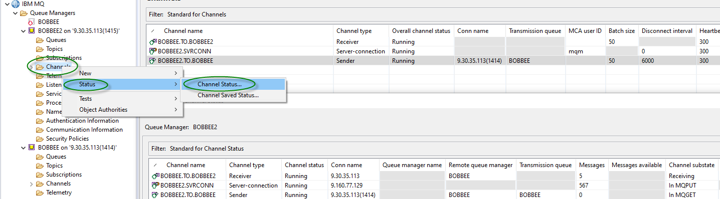
AMAUT34_Tech Fest - MQ Statistics AUT34_Tech Fest - MQ Statistics
DISPLAY CHANNEL STATUS MQExplorer
Notes:
Channel Status through MQExplorer MQ GUI
AS shown, click on Channels under QMGR and right click on a Channel ➔ Status
Shows in a graphical presentation the same information as the command line tool
The user can select SAVED Status

Slide 12
AMAUT34_Tech Fest - MQ Statistics AUT34_Tech Fest - MQ Statistics
TOPIC/PUBSUB STATUS
DISPLAY TPSSTATUS TYPE(TOPIC) command
Resolution of hierarchically inherited attributes
DIS TPSTATUS('/AUTO/TRUCK/FORD/F250') type(TOPIC) ALL
1 : DIS TPSTATUS('/AUTO/TRUCK/FORD/F250') type(TOPIC) ALL
AMQ8754I: Display topic status details.
TOPICSTR(/AUTO/TRUCK/FORD/F250) ADMIN(MYTOPIC)
CLUSTER( )
COMMINFO(SYSTEM.DEFAULT.COMMINFO.MULTICAST)
MDURMDL(SYSTEM.DURABLE.MODEL.QUEUE)
MNDURMDL(SYSTEM.NDURABLE.MODEL.QUEUE)
CLROUTE(NONE) DEFPSIST(NO)
DEFPRTY(0) DEFPRESP(SYNC)
DURSUB(YES) PUB(ENABLED)
SUB(ENABLED) PMSGDLV(ALLDUR)
NPMSGDLV(ALLAVAIL) RETAINED(NO)
MCAST(DISABLED) PUBCOUNT(0)
SUBCOUNT(0) PUBSCOPE(ALL)
SUBSCOPE(ALL) USEDLQ(YES)
Notes:
Status information is held for TOPICS
TPSSTATUS can be accessed through the command line runmqsc command
DIS TPSSTATUS
TYPE – TOPIC, SUB
Response Fields
TOPIC - ADMIN, CLROUTE, CLUSTER, COMMINFO, DEFPRESP, DEFPRTY, DEFPSIST, DURSUB, MCAST, MDURMDL, MNDURMDL, NPMSGDLV, PMSGDLV, PUB, PUBCOUNT, PUBSCOPE, RETAINED, SUB, SUBCOUNT, SUBSCOPE, USEDLQ
Sub Status – ACTCONN, DURABLE, LMSGDATE, LMSGTIME, MCASTREL, NUMMSGS, RESMDATE, RESMTIME, SUBID, SUBTYPE, SUBUSER
Pub Status - ,ACTCONN, LPUBDATE, LPUBTIME, MCASTREL, NUMPUBS

Slide 13
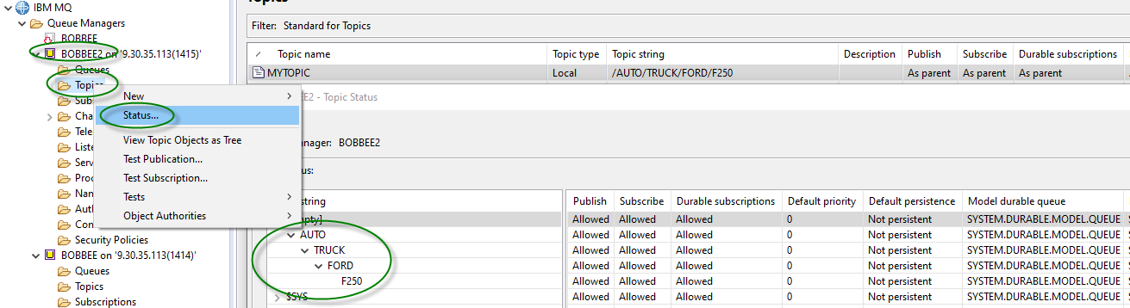
AMAUT34_Tech Fest - MQ Statistics AUT34_Tech Fest - MQ Statistics
DISPLAY TPSSTATUS MQExplorer

Slide 14
AMAUT34_Tech Fest - MQ Statistics AUT34_Tech Fest - MQ Statistics
Status of Applications
Application connections
What applications are active ?
Who is running the applications ?
Whether there any long running Units of Work (UOWs) outstanding ?
Application resources
Open queues, topics or subscriptions
Subscription definitions
Subscription owner/type
Notes:
Status of Applications
MQ will provide information on Applications using it’s resources
Will show you active applications
The users and system running applications
Will tell you if there are long running units of work
Will provide you with the resources being used

Slide 15
AMAUT34_Tech Fest - MQ Statistics AUT34_Tech Fest - MQ Statistics
Status of Applications – DISPLAY CONN cmd
User Application
DIS CONN(*) where(appltype eq user) type(all) all
1 : DIS CONN(*) where(appltype eq user) type(all) all
AMQ8276I: Display Connection details.
CONN(3853176301D06025)
EXTCONN(414D5143424F42424545202020202020)
TYPE(*)
PID(13225) TID(1)
APPLDESC( ) APPLTAG(amqsput)
APPLTYPE(USER) ASTATE(NONE)
CHANNEL( ) CLIENTID( )
CONNAME( ) CONNOPTS(MQCNO_SHARED_BINDING)
USERID(mqm) UOWLOG( )
UOWSTDA( ) UOWSTTI( )
UOWLOGDA( ) UOWLOGTI( )
URTYPE(QMGR)
EXTURID(XA_FORMATID[] XA_GTRID[] XA_BQUAL[])
QMURID(0.0) UOWSTATE(NONE)
CONNTAG(MQCT3853176301D06025BOBBEE_2022-04-06_08.54.20amqsput)
OBJNAME(BOBBEE_IN) OBJTYPE(QUEUE)
ASTATE(NONE) HSTATE(INACTIVE)
OPENOPTS(MQOO_OUTPUT,MQOO_FAIL_IF_QUIESCING)
READA(NO)
Application
User running Application
UOW Ststus
Application Resource
Notes:
Status of Applications
DIS CONN()
TYPE
CONN
HANDLE
ALL
Fields
CONN – APPLDESC, APPLTAG, APPLTYPE, ASID, ASTATE, CHANNEL, CLIENTID, CONNAME, CONNOPTS, EXTURIDNID, PID, PSBNAME, PSTID, QMURID, TASKNO, TID, TRANSID, UOWLOG, UOWLOGDA, UOWLOGTI, UOWSTATE, UOWSTDA, UOWSTTI, URTYPE, USERID
HANDLE – ASTATE, DEST, DESTQMGR, HSTATE, OBJNAME, OBJTYPE, OPENOPTS, QSGDISP, READA, SUBID, SUBNAME, TOPICSTR

Slide 16
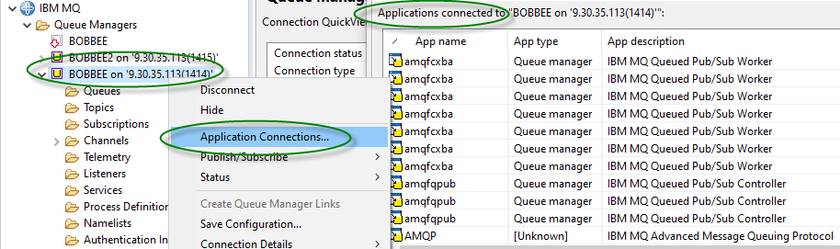
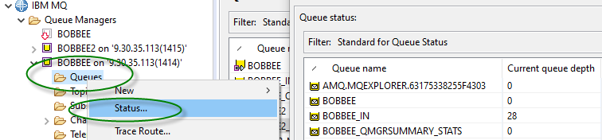
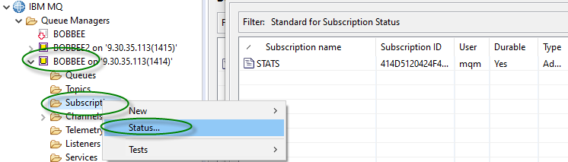
AMAUT34_Tech Fest - MQ Statistics AUT34_Tech Fest - MQ Statistics
MQExplorer
Status of Applications
Open Queues
Subscriptions
Notes:
Application Status through MQExplorer MQ GUI
AS shown, click on Queues ➔ Status or Subscriptions ➔ Status
Shows in a graphical presentation the same information as the command line tool
The user can select SAVED Status

Slide 17


AMAUT34_Tech Fest - MQ Statistics AUT34_Tech Fest - MQ Statistics
STATISTICS AND ACCOUNTING
Accounting and Statistics – Platform differences
Statistics: Data about resource usage and activity within the QMGR
Accounting: Information about what tasks have been doing
z/OS
Written as SMF records
Type 115 and 116
Distributed
Written as PCF format messages
On specific queues
SYSTEM.ADMIN.*.QUEUE
Notes:
Queue managers generate accounting and statistics messages to record information about the MQI operations performed by IBM® MQ applications, or to record information about the activities occurring in an IBM MQ system.
Accounting messages: Accounting messages are used to record information about the MQI operations performed by IBM MQ applications, see Accounting messages.
Statistics messages: Statistics messages are used to record information about the activities occurring in an IBM MQ system, see Statistics messages. Some activity recorded in statistics messages relates to internal queue manager operations.
Accounting and statistics messages are delivered to one of two system queues. User applications can retrieve the messages from these system queues and use the recorded information for various purposes:
Account for application resource use.
Record application activity.
Capacity planning.
Detect problems in your queue manager network.
Assist in determining the causes of problems in your queue manager network.
Improve the efficiency of your queue manager network.
Familiarize yourself with the running of your queue manager network.
Confirm that your queue manager network is running correctly.

Slide 18
AMAUT34_Tech Fest - MQ Statistics AUT34_Tech Fest - MQ Statistics
Statistics Records TYPE 115 (z/OS)
SMF 115 Subtype 1
System information, for example, related to the logs and storage
SMF 115 Subtype 2
Information about number of messages, buffer and paging information
Queue-sharing group information related to the coupling facility and DB2
SMF 115 Subtype 5/6
Detailed information about internal storage usage in the queue manager address space.
While you can view this information, some of it is intended only for IBM use.
SMF 115 Subtype 7
Storage manager summary information.
While you can view this information, some of it is intended only for IBM use.
SMF 115 Subtype 201
Page set input/output information
SMF 115 Subtype 215
Bufferpool information when the queue manager is running in OPMODE=(NEWFUNC,800) mode
SMF 115 Subtype 216
Queue information
SMF 115 Subtype 231
System information for the CHIN address space.

Slide 19
AMAUT34_Tech Fest - MQ Statistics AUT34_Tech Fest - MQ Statistics
Accounting Records TYPE 116 (z/OS)
SMF 116 subtype 0
Message manager records
SMF 116 subtype 1 & 2
Data for each task, at thread and queue level.
SMF 116 subtype 10
Data for channels

Slide 20
AMAUT34_Tech Fest - MQ Statistics AUT34_Tech Fest - MQ Statistics
Collecting Statistics Messages (Distributed)
Collects information about IBM MQ resources
Overall, Per Queue, Per Channel
Queue Manager Attributes
STATINT – Statistics Interval
STATMQI – Overall MQI Statistics
STATQ – Queue Statistics
STATCHL – Channel Statistics
STATACLS – Auto-defined Cluster Sender Channel Statistics
Queue Attribute
STATQ – Queue Statistics
Channel Attribute
STATCHL – Channel Statistics
PCF Header fields
MQCMD_STATISTICS_MQI – overall information
MQCMD_STATISTICS_Q – per queue
MQCMD_STATISTICS_CHANNEL – per channel
SYSTEM.ADMIN.STATISTICS.QUEUE
ALTER QMGR STATINT(1800)
STATMQI(ON)
STATQ(ON)
STATCHL(HIGH)
STATACLS(QMGR)
ALTER QLOCAL(q-name)
STATQ(QMGR)
ALTER CHL(chl-name)
CHLTYPE(SDR)
STATCHL(QMGR)
Notes:
Statistics can be turned on per
Overall
Per Queue
Per channel
At the Queue Manager (OVERALL) the Statistics can be activated by setting
STATINT(1800) - Statistics messages are generated at configured intervals, and when a queue manager shuts down in a controlled fashion. The configured interval is controlled by the STATINT queue manager attribute, which specifies the interval, in seconds, between the generation of statistics messages. The default statistics interval is 1800 seconds (30 minutes).
STATMQI(ON) - Use the queue manager attribute STATMQI to control the collection of MQI statistics information. Statistics messages are generated only for queues that are opened after statistics collection has been enabled.
STATQ(ON) - Use the queue attribute STATQ and the queue manager attribute STATQ to control the collection of queue statistics information. Queue statistics are incremented only for operations using IBM® MQ MQI Object Handles
STATCHL(HIGH) - This QMGR/Channel attribute controls the collection of statistics data for channels. The possible values are: QMGR Statistics data collection for this channel is based upon the setting of the queue manager attribute STATCHL.
This value is the default value. OFF Statistics data collection for this channel is disabled.
LOW Statistics data collection for this channel is enabled with a low ratio of data collection.
MEDIUM Statistics data collection for this channel is enabled with a moderate ratio of data collection.
HIGH Statistics data collection for this channel is enabled with a high ratio of data collection.
STATACLS(QMGR) - Use the QMGR/channel attribute STATCHL to control the collection of channel statistics information. You can also set queue manager attributes to control information collection.

Slide 21
AMAUT34_Tech Fest - MQ Statistics AUT34_Tech Fest - MQ Statistics
Collecting Accounting Messages (Distributed)
Collects information about applications which connect to the Queue Manager
Overall
Per Queue
Queue Manager Attribute
ACCTINT – Accounting Interval
ACCTMQI – Overall MQI Accounting
ACCTQ – Queue Accounting
Queue Attribute
ACCTQ – Queue Accounting
PCF Header fields
MQCMD_ACCOUNTING_MQI – overall information
MQCMD_ACCOUNTING_Q – per Queue
SYSTEM.ADMIN.ACCOUNTING.QUEUE
ALTER QMGR
ACCTINT(1800)
ACCTMQI(ON)
ACCTQ(ON)
ALTER QLOCAL(q-name)
ACCTQ(QMGR)
Notes:
MQI accounting messages MQI accounting messages contain information relating to the number of MQI calls made using a connection to a queue manager.
Queue accounting messages Queue accounting messages contain information relating to the number of MQI calls made using connections to a queue manager, grouped by queue. Accounting messages are recorded only for local queues. If an application makes an MQI call against an alias queue, the accounting data is recorded against the base queue, and, for a remote queue, the accounting data is recorded against the transmission queue.
Accounting Messages can be turned on per
Overall
Per Queue
At the Queue Manager (OVERALL) the Statistics can be activated by setting
ACCTINT(1800) - The queue manager attribute, ACCTINT, specifies the time, in seconds, after which intermediate accounting messages can be automatically written
ACCTMQI(ON) - Use the queue manager attribute ACCTMQI to control the collection of MQI accounting information.
ACCTQ(ON) - Use the queue attribute ACCTQ and the queue manager attribute ACCTQ to control the collection of queue accounting information.

Slide 22
AMAUT34_Tech Fest - MQ Statistics AUT34_Tech Fest - MQ Statistics
What can I discover ?
Open details
First open time, last close time for a queue
MQCMD_ACCOUNTING_Q message on Distributed
MQGET details
Count, total bytes, msg-size (min / max), time-on-queue (min / avg / max) (persistent / non-persistent) for a queue
MQCMD_ACCOUNTING_Q message on Distributed
API counts
For each of the MQ API's (MQPUT / MQGET/ ...) across the queue manager
MQCMD_STATISTICS_MQI on Distributed
Number of messages transferred (persistent / non-persistent) on a channel
MQCMD_STATISTICS_CHANNEL on Distributed
Batch Info (total / number full / avg size) on a channel
MQCMD_STATISTICS_CHANNEL on Distributed
Notes:
CreateDate
CreateTime
QType
QDefinitionType
OpenCount
OpenDate
OpenTime
CloseDate
CloseTime
PutCount
PutFailCount
Put1Count
Put1FailCount
PutBytes
PutMinBytes
PutMaxBytes
GetCount
GetFailCount
GetBytes
GetMinBytes
GetMaxBytes
BrowseCount
BrowseFailCount
BrowseBytes
BrowseMinBytes
BrowseMaxBytes
TimeOnQMin
TimeOnQAvg
TimeOnQMax

Slide 23
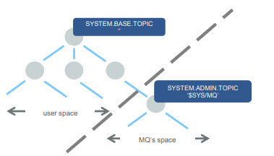
AMAUT34_Tech Fest - MQ Statistics AUT34_Tech Fest - MQ Statistics
System topics – new for MQ V9
IBM MQ V9 (and the M2000 Appliance) has created its own branch of the topic tree
“$SYS/MQ”
This is used for publishing and subscribing to data from the queue manager
A new default object sits at the root of this branch, SYSTEM.ADMIN.TOPIC
It sits below SYSTEM.BASE.TOPIC but consider it a completely new tree
No attributes are inherited from above
No authorities are inherited from above
The topic nodes are not matched by wildcards above it
E.g. Subscribing to ‘#’ will not match anything starting “$SYS/MQ”
Out of the box, access to the branch is restricted to administrators only
Access can be granted to other users through the definition of admin topics and access control at key points below $SYS/MQ
Notes:
System topics in queue manager topic trees are used for resource monitoring (some of which is similar to the content of statistics messages) and as a way of consuming application activity trace.
From IBM MQ 9.0, you can monitor queue manager statistics by using the simple publish/subscribe mechanism and either the amqsrua sample application, or your own application. Statistics are published to a system topic under $SYS/MQ/INFO/QMGR that help users monitor resources. These statistics can be viewed either by running the amqsrua sample application, or by writing an application that subscribes to the resource monitoring system topic in a similar way to amqsrua

Slide 24
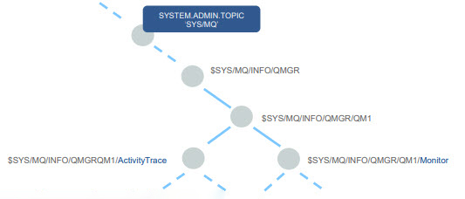
AMAUT34_Tech Fest - MQ Statistics AUT34_Tech Fest - MQ Statistics
New system topic publications
MQ V9 publishes two types to data under the system topic branch
Application activity trace
Resource monitoring
Each queue manager listens for subscriptions to recognized topic strings and only publishes when subscriptions exist
Notes:
Queue managers generate accounting and statistics messages to record information about the MQI operations performed by IBM® MQ applications, or to record information about the activities occurring in an IBM MQ system.
Accounting messages - Accounting messages are used to record information about the MQI operations performed by IBM MQ applications, see Accounting messages.
Statistics messages - Statistics messages are used to record information about the activities occurring in an IBM MQ system, see Statistics messages. Some activity recorded in statistics messages relates to internal queue manager operations.
Accounting messages and statistics messages as described here are not available on IBM MQ for z/OS®, but equivalent functionality is available through the System Management Facility (SMF).
Accounting and statistics messages are delivered to one of two system queues. User applications can retrieve the messages from these system queues and use the recorded information for various purposes:
Account for application resource use.
Record application activity.
Capacity planning.
Detect problems in your queue manager network.
Assist in determining the causes of problems in your queue manager network.
Improve the efficiency of your queue manager network.
Familiarize yourself with the running of your queue manager network.
Confirm that your queue manager network is running correctly.

Slide 25
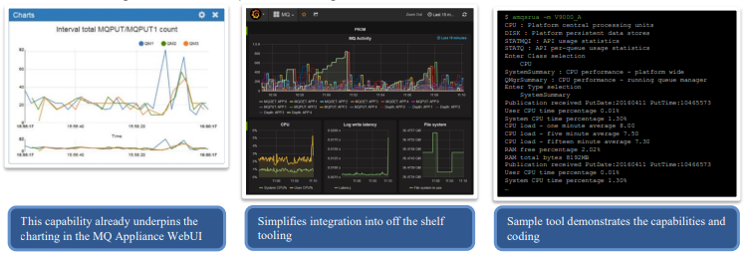
AMAUT34_Tech Fest - MQ Statistics AUT34_Tech Fest - MQ Statistics
Subscribe to MQ and system monitoring information
Subscribe for a regular feed of performance monitoring information
Familiar queue manager wide and queue level statistics
Plus new CPU, memory and disk usage
For example, disk reads/writes, disk latency
Enables integration into multiple monitoring solutions
Notes:
System monitoring information is Not published unless there is a Subscription for the information.
Creating a subscriptions to topis like the following will produce information to your target queue:
$SYS/MQ/INFO/QMGR/BOBBEE/Monitor/CPU/QMgrSummary
[mqm@fibbing1 ~]$ amqsrua -m BOBBEE
CPU : Platform central processing units
DISK : Platform persistent data stores
STATMQI : API usage statistics
STATQ : API per-queue usage statistics
STATAPP : Per-application usage statistics
Enter Class selection
==> DISK
SystemSummary : Disk usage - platform wide
QMgrSummary : Disk usage - running queue managers
Log : Disk usage - queue manager recovery log
Enter Type selection
==> QMgrSummary
This information can be piped to a Queue which feeds Prometheus which is used to enable Grafana as in Mark Taylors sample application

Slide 26
AMAUT34_Tech Fest - MQ Statistics AUT34_Tech Fest - MQ Statistics
AMQSRUA System stat Sample program
Sample program installed with ‘Tools’
Command line execution
Subscribes to System Stat Topics
Digests and transforms PCF to readable statistics
Can be run in DEBUG mod to provide Meta Topic Data
CLASS name. IBM MQ resource usage publications are associated with a class. The classes represent the top level in the tree of metadata that describes the available resource usage information.
CPU
Returns information about CPU usage.
DISK
Returns information about disk usage.
STATMQI
Returns information about MQI usage.
STATQ
Returns information about per-queue MQI usage.
Notes:
The amqsrua sample application showcases a way to consume IBM® MQ monitoring publications and display performance data that is published by queue managers. This data can include information about the CPU, memory, and disk usage. You can also see data equivalent to the STATMQI PCF statistics data. The data is published every 10 seconds and is reported while the command runs.You can run the command with just the queue manager name and interactively step through to choose the CLASS, then TYPE and then object parameters that are available for the queue manager at each step. If you know the CLASS, TYPE and object names for which you want to see information, you can specify them when you run the amqsrua command.
By default, the amqsrua application looks for statistics that are published by the queue manager under the topic tree $SYS/MQ/INFO/QMGR. Other components or applications can use a similar mechanism to publish under a different topic starting point. For example, the IBM MQ Bridge to Salesforce that is available on x86-64 Linux® platforms, publishes statistics under $SYS/Application/runmqsfb. From IBM MQ 9.1.0, you can use the -p parameter to specify where amqsrua looks for the statistics for these other components on both Linux and Windows.
-m
Queue manager name. The queue manager must be running. If you do not specify a queue manager name, statistics for the default queue manager are displayed.
-c
CLASS name. IBM MQ resource usage publications are associated with a class. The classes represent the top level in the tree of metadata that describes the available resource usage information.
CPU Returns information about CPU usage.
DISK Returns information about disk usage.
STATMQI Returns information about MQI usage.
STATQ Returns information about per-queue MQI usage.
STATAPP Returns information about usage statistics for the application specified.

Slide 27
AMAUT34_Tech Fest - MQ Statistics AUT34_Tech Fest - MQ Statistics
Programmable command formats (PCFs) reference
PCFs define command and reply messages that can be exchanged across a network between a program
Interacts with target Queue Manager
PCF Commands for most MQSC commands
PCF Command Reference (link)
Introduction to IBM MQ Programmable Command Formats (link)
Commonly used in Python and JAVA
PCF SAMPLE Program
Sample PYTHON scripts (link)
Notes:
PCFs define command and reply messages that can be exchanged across a network between a program and any queue manager that supports PCFs. This simplifies queue manager administration and other network administration.
PCF commands and responses have a consistent structure including of a header and any number of parameter structures of defined types

Slide 28
AMAUT34_Tech Fest - MQ Statistics AUT34_Tech Fest - MQ Statistics
DEMO
DEMO of Python scripts
System Statistics – Collect system statistics, i.e., CPU, memory file system usage by QMGR
Queue Statistics – Collect queue statistics using INQ_QUEUE, INQ_QUEUE_STATS and RESET_QSTATS commands via PYMQI and uses ‘amqsrua’ to collect further information about the queue GET and PUT statistics
Channel Statistics - Collect channel statistics using INQ_CHANNEL, INQ_CHANNEL_STATS commands via PYMQI
Scripts connect to a Queue Manager and issue PCF Commands against the queue manager. The scripts also execute the ‘amqsrua’ sample program for a single instance of a multi faceted request and then parses the result for specific values.
The scripts produce a CSV output with a header line as the first line. The scripts are written to collect all the statistics for each one to a monthly report file which can be imported into EXCEL for further processing.
Notes:
The DEMO centers on three PYTHON scripts
SYSTEM STATS
QUEUE STATS
CHANNEL STATS
The scripts execute a variety of MQ Commands and amqsrua commands.
For the amqsrua commands. The scripts capture the text output and parse the output looking for keywords to center on the metrics
For the MQ commands, The information is in PCF format which PYMQI was created to parse.
The scripts are kept in GITHUB and there is a link at the end to the scripts run in this DEMO

Slide 29

AMAUT34_Tech Fest - MQ Statistics AUT34_Tech Fest - MQ Statistics
Links and Winks
GITHUB Script samples – Scripts and Client QMGR Connect code used in this DEMO
MS0P Support Pack – The Extended Management plug-ins for the IBM WebSphere MQ Explorer extend the capabilities for queue manager configuration, and display additional information about the queue managers
IBM MQ and Open-Source Monitoring – Technical Conference presentation on monitoring
MP1B: z/OS - Interpreting acct and stat data - SupportPac contains a program for formatting IBM MQ statistics and accounting SMF records. There are other programs that help you monitor your IBM MQ system on z/OS
Building and Running the IBM mq_prometheus collector on Windows
Notes:
Links to information covered in this presentation

Slide 30

AMAUT34_Tech Fest - MQ Statistics AUT34_Tech Fest - MQ Statistics

